Slide 1
Comparative Evaluation of YOLOv8 Models for Food Object Detection
Prepared by:
Viktorija Projkova 1/2022
David Naumovski 100/2022
Mihajlo Naumoski 101/2022
Mentor:
Assoc. Prof. Dr.sc. Hristijan Gjoreski

Slide 2
Table of contents
01
02
03
04
Dataset description
Introduction to YOLO
Conclusion
Model comparison & LLM integration

Slide 3
01
Introduction to YOLO models

Slide 4
YOLO Models Overview (YOLOv8)
YOLO (You Only Look Once) is a real time one stage object detector.
Performs localization and classification in a single forward pass (bounding box + class label + confidence score).
We used Ultralytics YOLOv8 models with pre-trained weights on MS COCO.
Transfer learning: models were fine tuned on our food dataset (44K already annotated images)
YOLOv8n (Nano) ≈ 3.2M parameters
YOLOv8s (Small) ≈ 11.2M parameters
YOLOv8m (Medium) ≈ 25.9M parameters

Slide 5
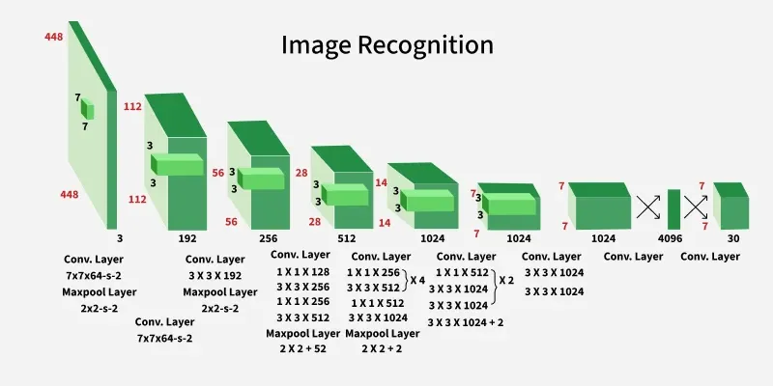
YOLO Models Architecture

Slide 6
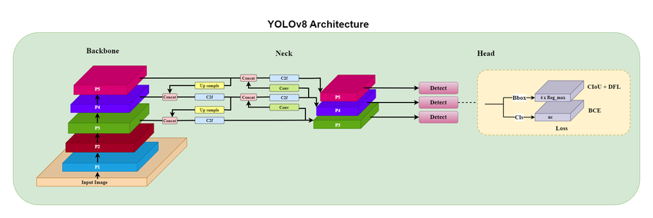
YOLO Models Architecture

Slide 7
02
Dataset description

Slide 8
Dataset structure and splits
Training data: ~44,000 already pre annotated images
Annotations available for:
Train
Validation
Test data: unlabeled images (no annotations)used for qualitative evaluation (visual inspection of predicted boxes)
Quantitative evaluation: performed on validation set (labeled), metrics: precision, recall, mAP.
Qualitative evaluation: performed on unlabeled test images, checked box localization and class predictions
External evaluation: Emteq images used as additional real world test data

Slide 9
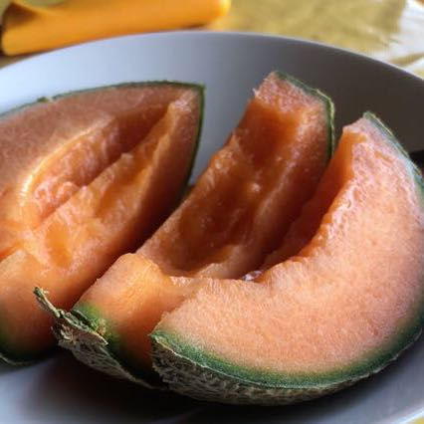
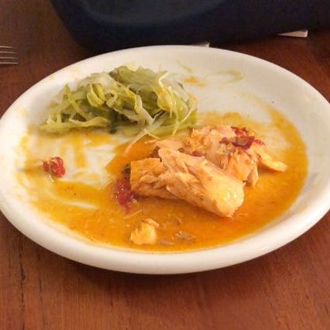
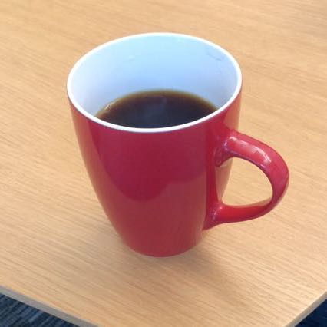
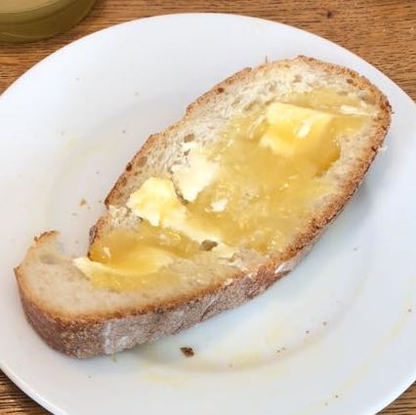
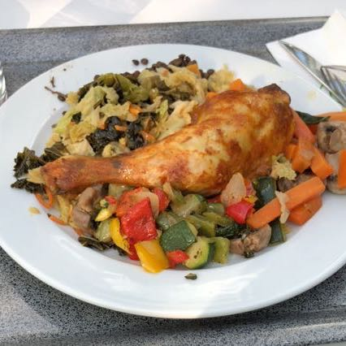
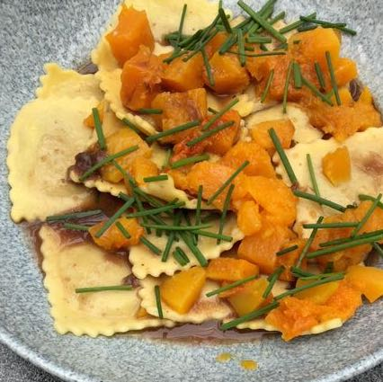
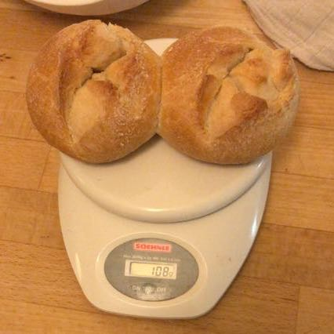
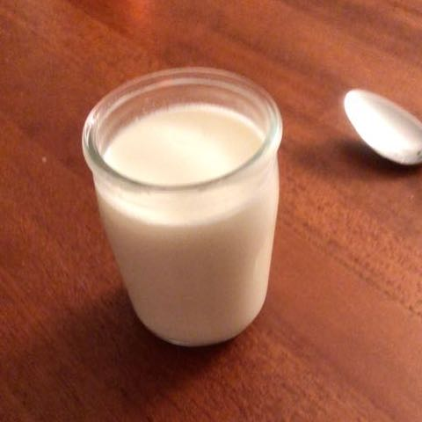
Images from the Food recognition 2022 dataset

Slide 10
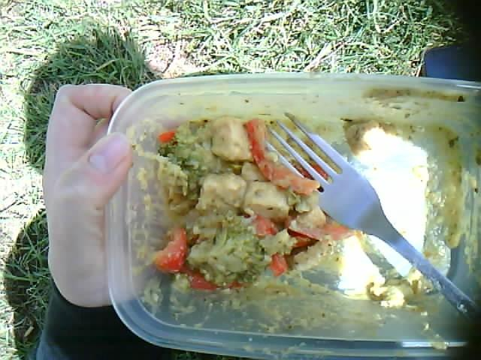
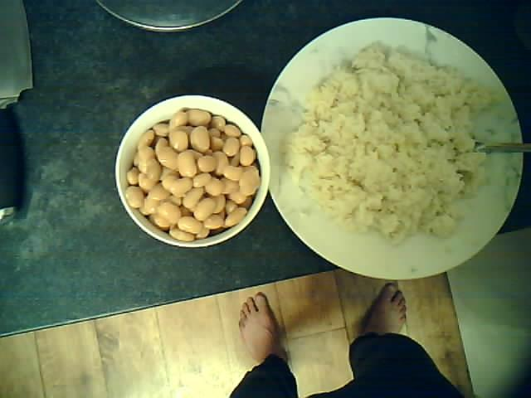
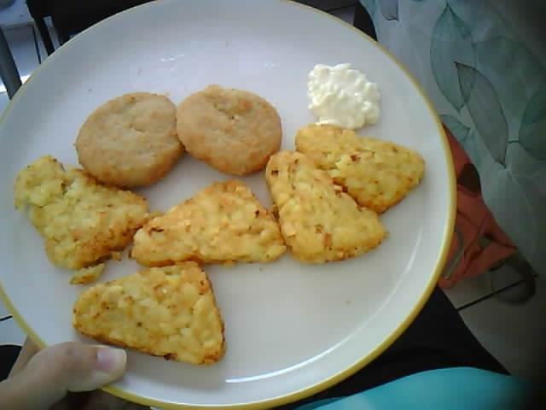
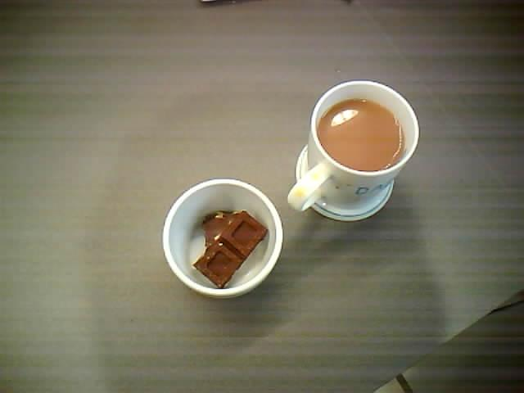
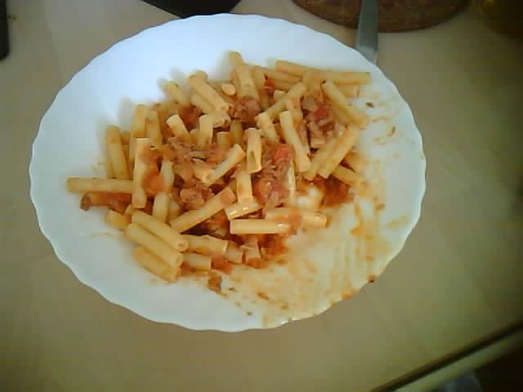
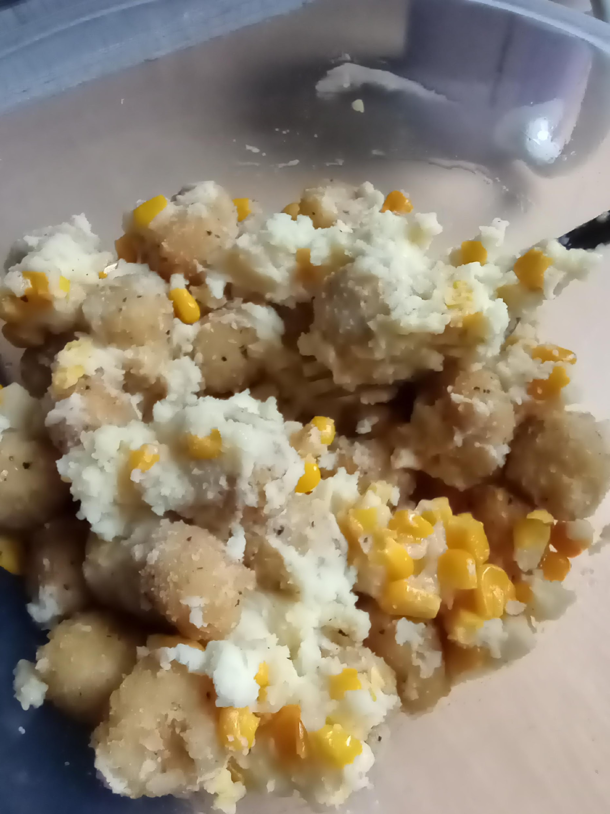
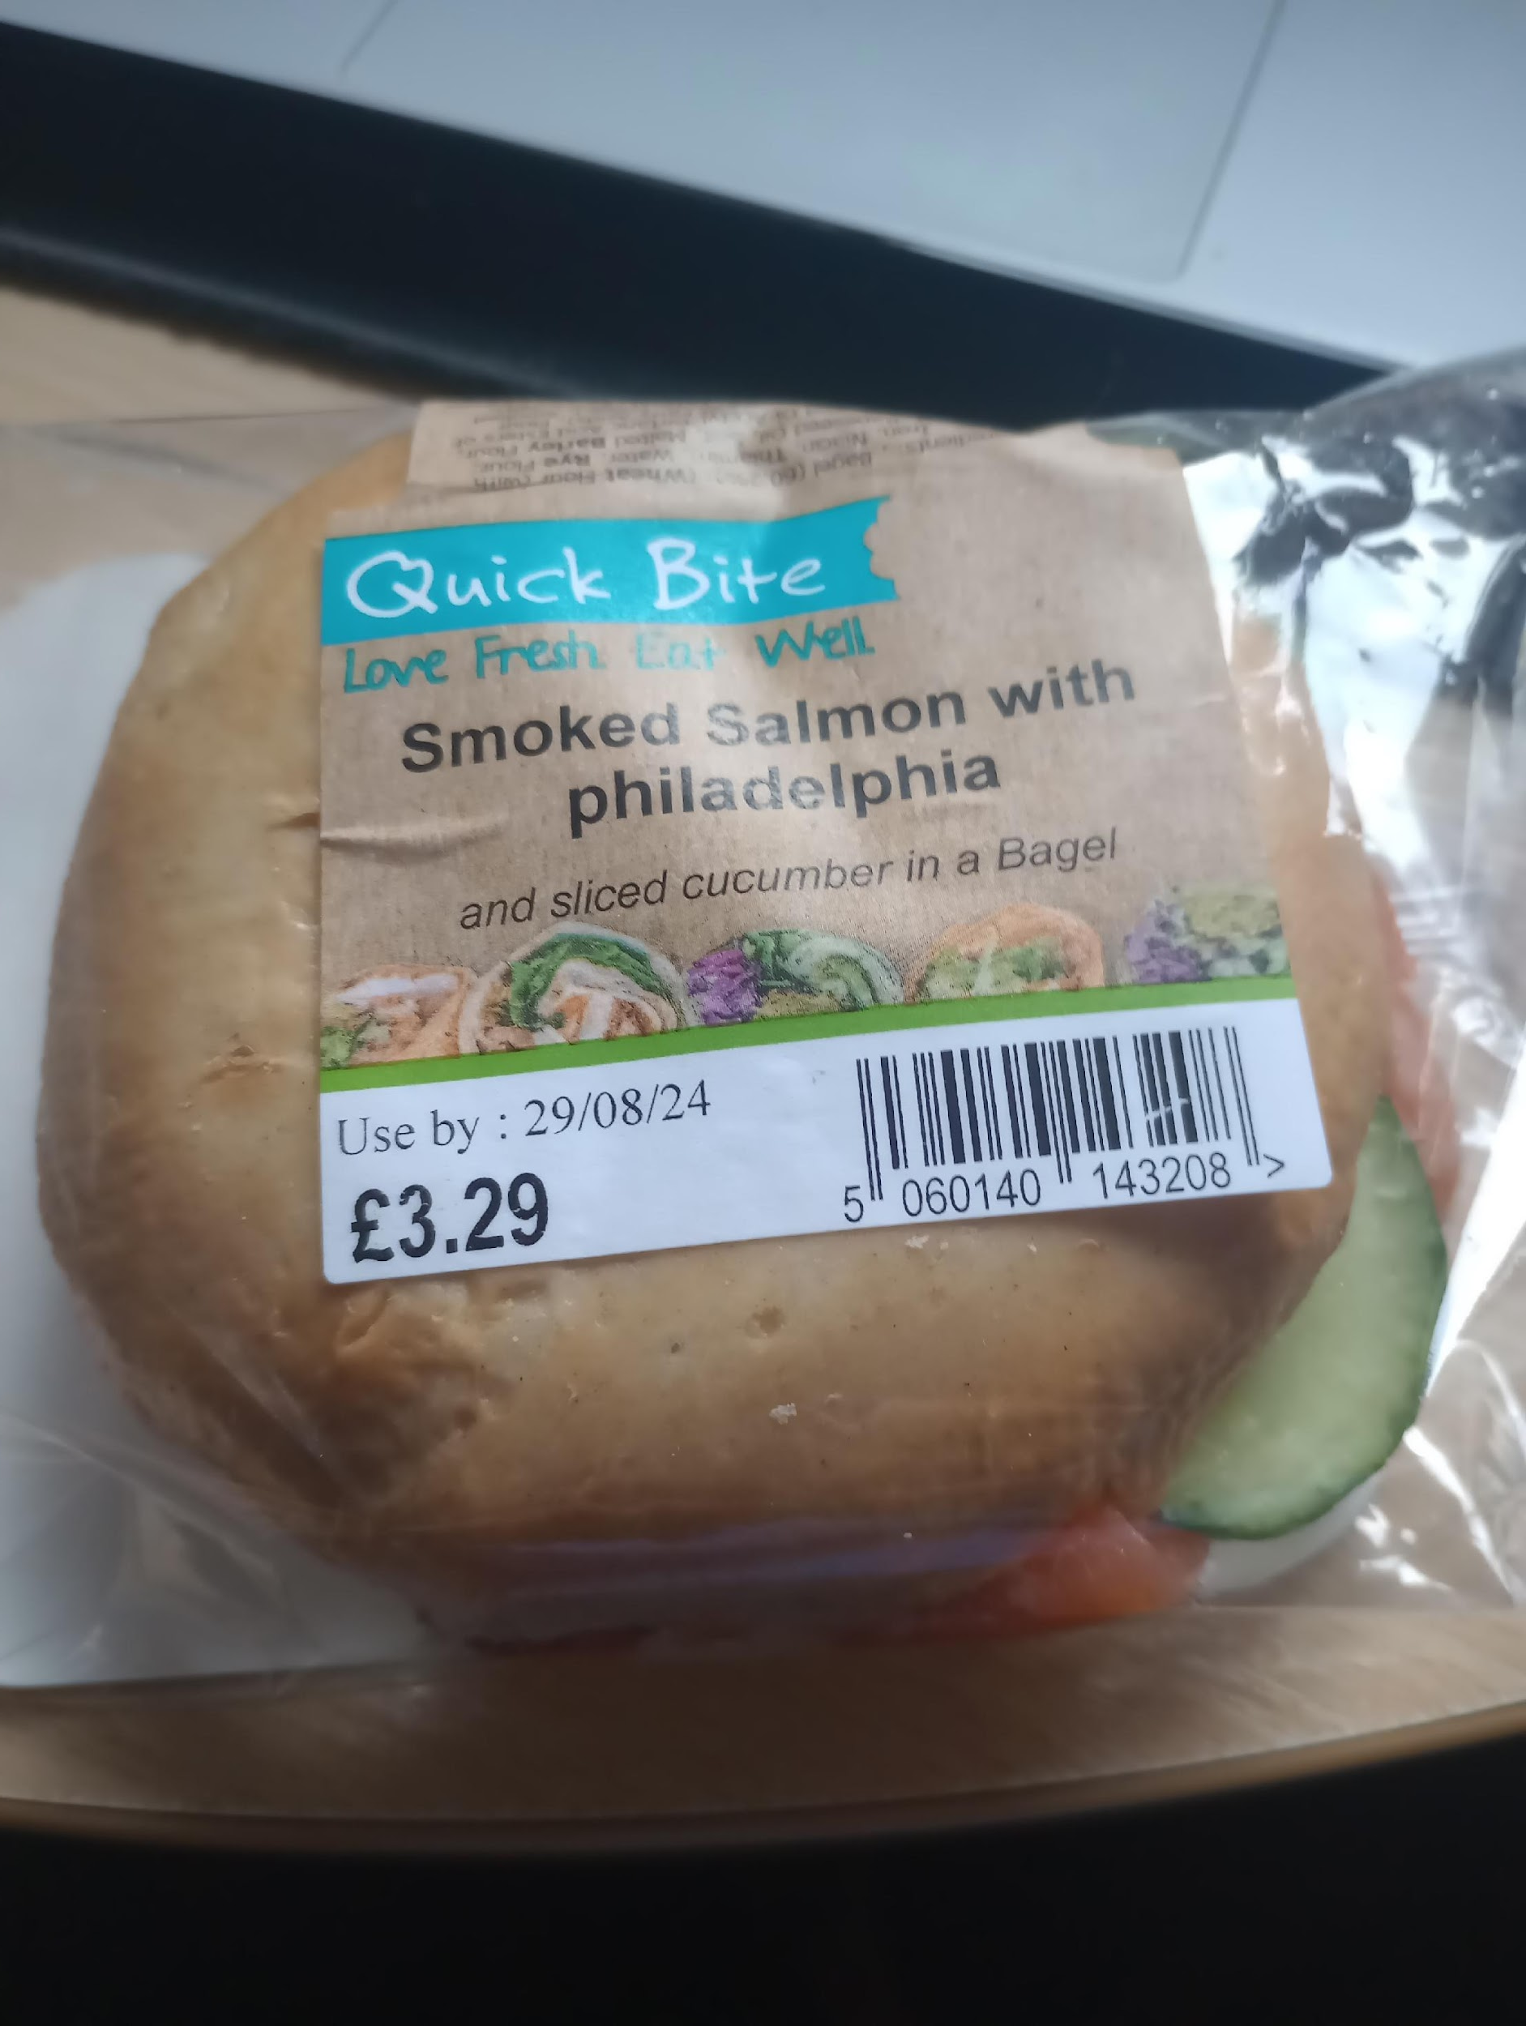
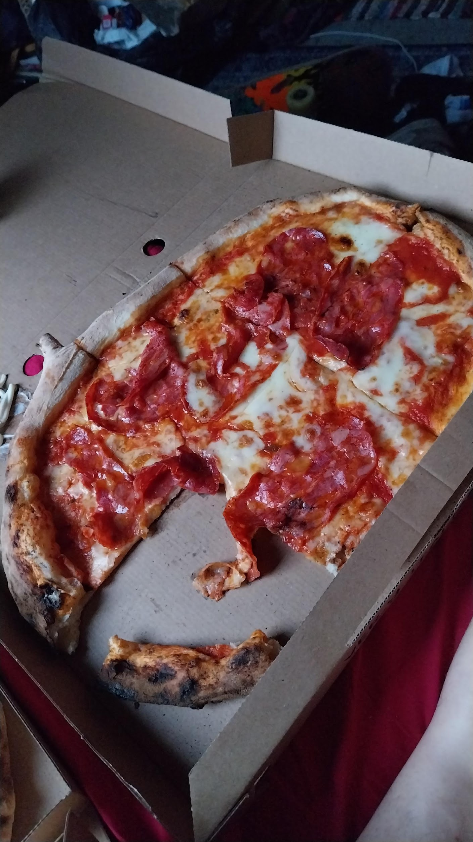
Images from the Food ID – Emteq dataset

Slide 11
Evaluation Metrics
Precision – fraction of predicted detections that are correct(low false positives)
Recall – fraction of ground-truth objects that were detected(low false negatives)
IoU (Intersection over Union) – overlap between predicted and true bounding box (used to decide if a detection is correct)
mAP@0.5 – mean Average Precision at IoU threshold 0.5
mAP@0.5:0.95 – stricter mAP averaged over IoU thresholds 0.50–0.95
Inference speed (ms/image or FPS) – runtime performance for deployment

Slide 12
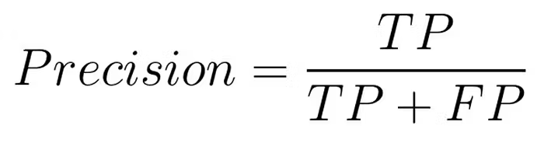
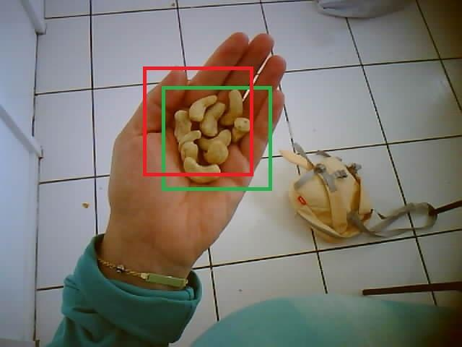
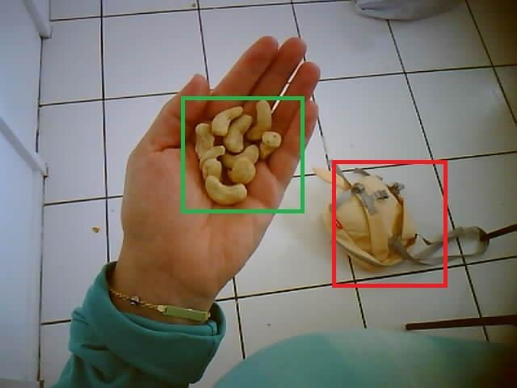
Precision
true positive
false positive

Slide 13
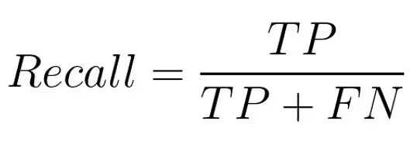
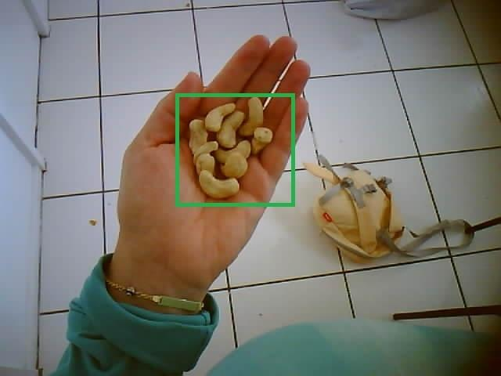
Recall
true positive
false negative

Slide 14
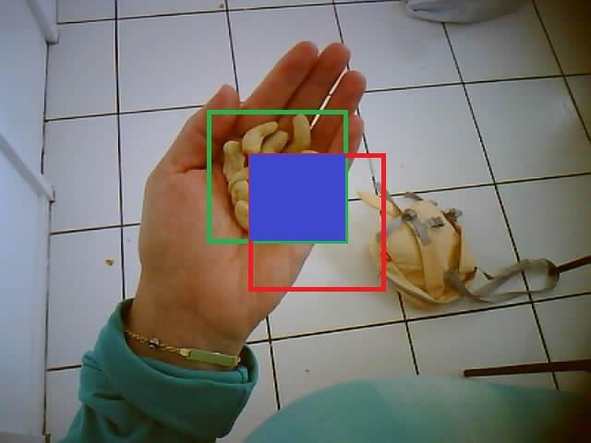
IoU (Intersection over Union)

Slide 15
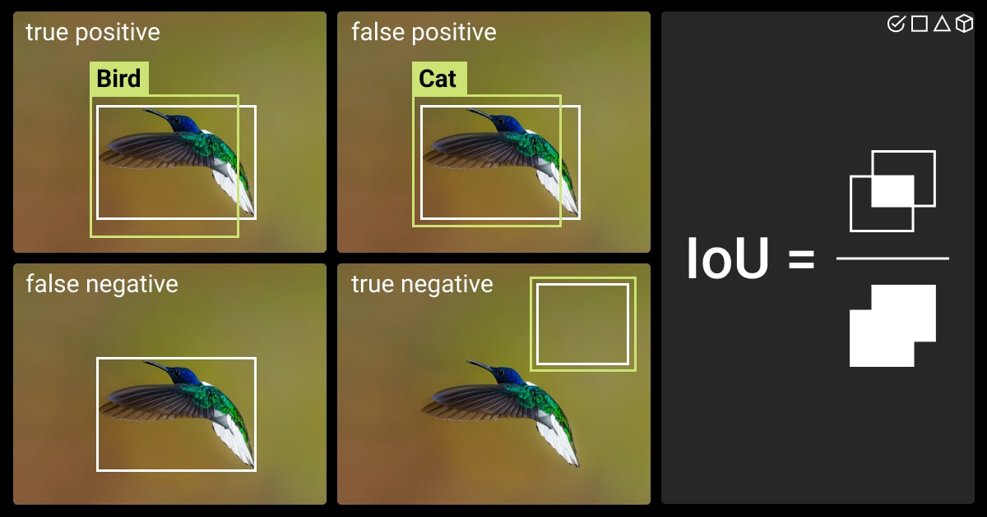

Slide 16
Confidence threshold
Meant to filter predictions before evaluation
Detections are ranked based on their confidence score while evaluating, sorted in a descending order
Detections that do not pass a certain confidence threshold are discarded
Confidence in an internally calculated metric - meant to symbolise hwos ure is the model in its prediction

Slide 17
mAP@0.5
Make predictions on validation set and draw bounding boxes
For each class separately match boxes to ground truth boxes:
if IoU > IoU threshold(0.5 in this case) -> True Positive
if IoU < threshold -> False Positive
If ground truth box is unmatched -> False Negative
Construct a Precision Recall curve based on different confidence thresholds (again for each class separately) by sweeping through the thresholds:
First (step 1) accept a high confidence threshold and calculate Precision and Recall
For the following steps decrease the confidence threshold and do the calculations again and again (Doing the sweep top to bottom for the predictions ranked by their confidence score)
Every step is a dot on the graph

Slide 18
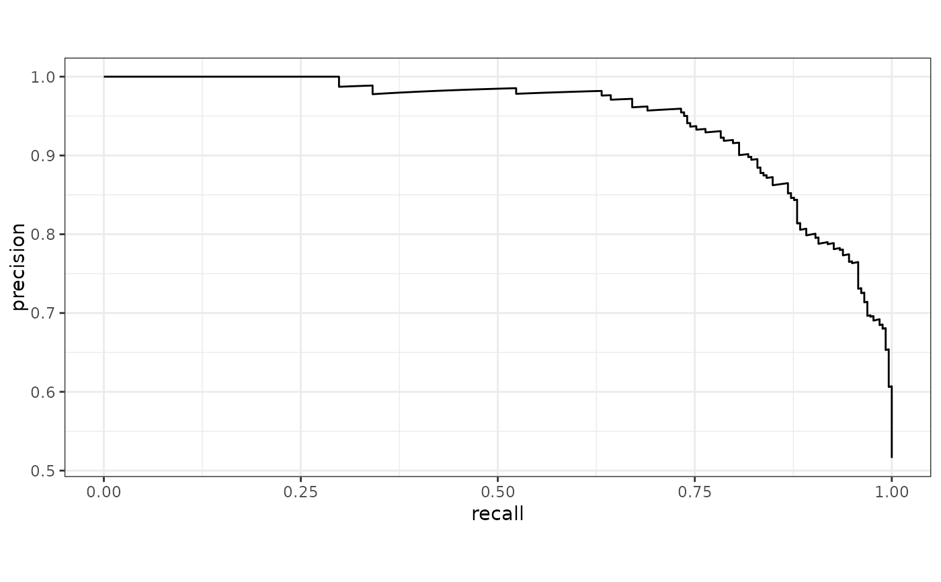
mAP@0.5

Slide 19
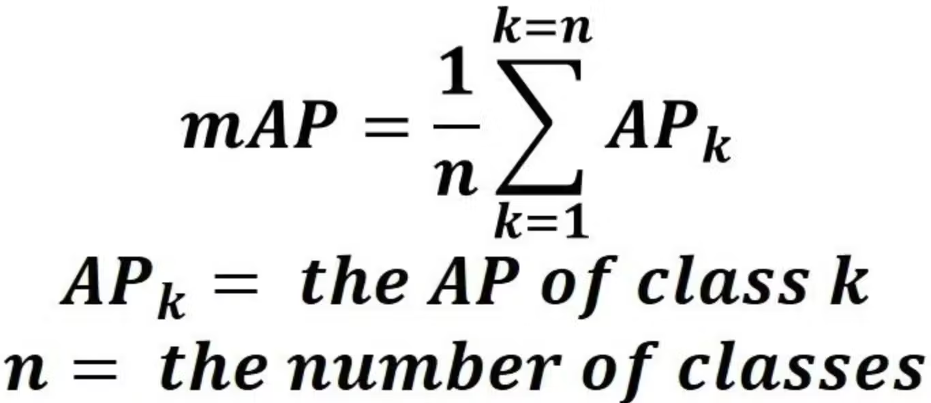
mAP@0.5
The are under the Precision-Recall curve is known as AP-Average Precision
For the calculation of this area we use Precision Interpolation as to standardise the curve and remove noise - this means for each recall level use the maximum precision that was gained from before (this removes the natural increase and decrease of precision through the curve)
The average of AP through all the classes is known as mAP- mean Average Precision

Slide 20
mAP@0.5:0.95
Inference speed
A stricter metric than mAP@0.5
An average of mAP at every IoU threshold from 0.5 to 0.95 with step 0.05
mAP@0.5:0.95 focuses on detection quality while mAP@0.5 focuses only on detection correctness
Inference speed measures how fast the model processes images (e.g., milliseconds per image or FPS) during deployment.
Faster inference enables real-time applications, but often trades off with model size and accuracy.

Slide 21
Other metrics from YOLO training
Box loss (box_loss) measures how far predicted bounding boxes are from ground-truth boxes, using IoU-based regression loss during training.
Classification loss (cls_loss) measures how often the model predicts the wrong class label, computed using classification loss (e.g., BCE or focal loss) during training.
DFL loss (dfl_loss) measures how accurately the model predicts box boundaries as probability distributions, improving fine-grained localization during training

Slide 22
General metric quality
Speed
Inference speed: ≥ 20 FPS (real-time), ≥ 5 FPS (offline)
Validation Metrics
Precision: > 0.75
Recall: > 0.65
mAP@0.5: > 0.70
mAP@0.5:0.95: > 0.45
Training Losses (trend-based)
box_loss: < 1.5 and decreasing
cls_loss: < 1.0 and decreasing
dfl_loss: < 2.0 and decreasing

Slide 23
03
Model comparison & LLM integration
https://colab.research.google.com/drive/1G_cBMYDDwW4bThjDGTDKaA6-Oo5H4cb1?usp=drive_link
https://colab.research.google.com/drive/1Vhk6FLzhc2JFwVSdgc_BtQrYL3s4iDB0?usp=drive_link
https://colab.research.google.com/drive/1tT4ksfBRD6La27PJiGd6wGV0lrhAKNKV?usp=drive_link
https://colab.research.google.com/drive/1m-rgc9wjDSmFg8k4Rmne0FgEuyH0ka0N?usp=sharing

Slide 24
Model comparison
All models were trained using the same dataset and pipeline
Main difference between variants: model capacity (parameters)
Larger models generally provide: better localization and fewer missed detections, higher compute cost and slower inference
Comparison includes: validation metrics (labeled data), qualitative testing on unlabeled test images and Emteq images

Slide 25
Yolov8n
Qualitative Evaluation – Kaggle Test Split

Slide 26
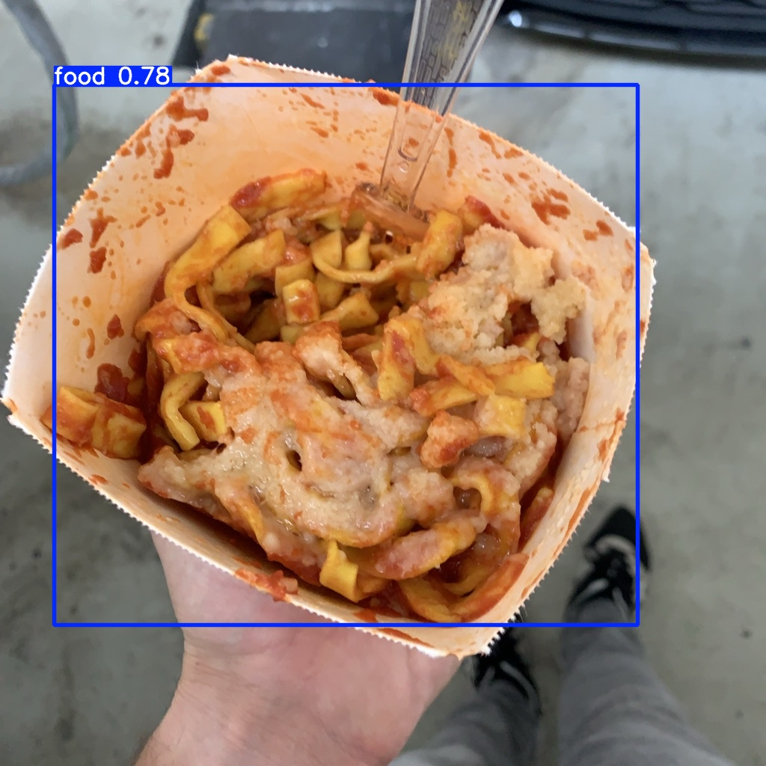

Slide 27
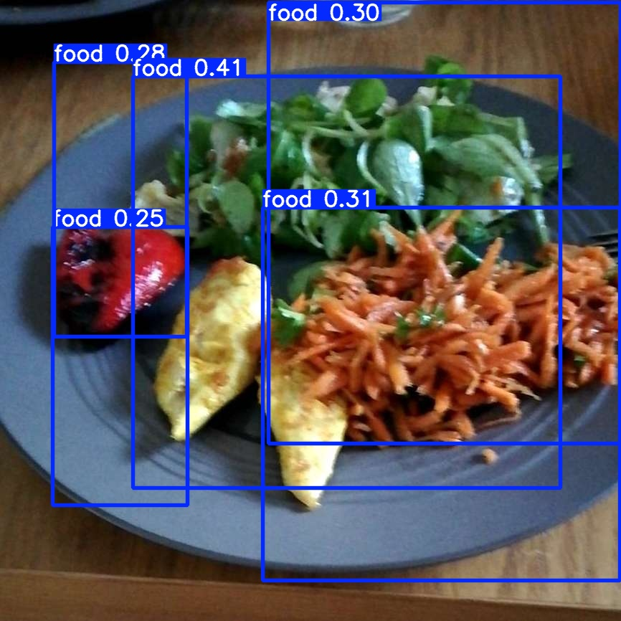

Slide 28
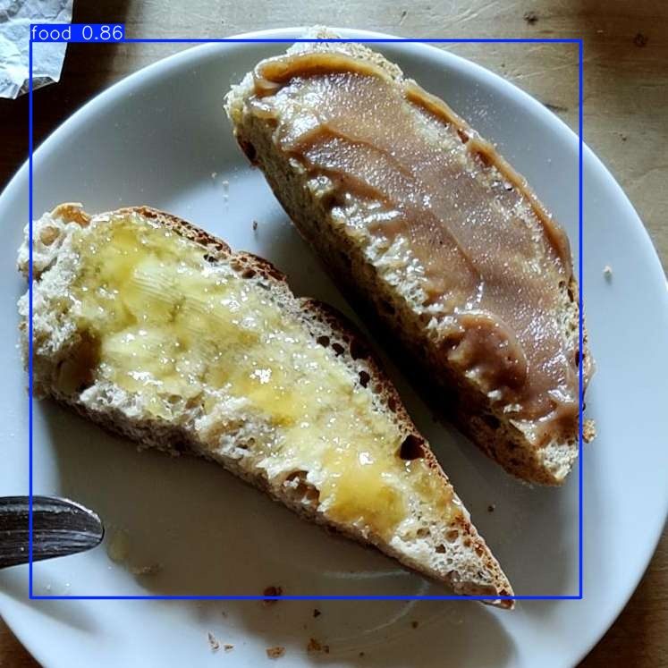

Slide 29
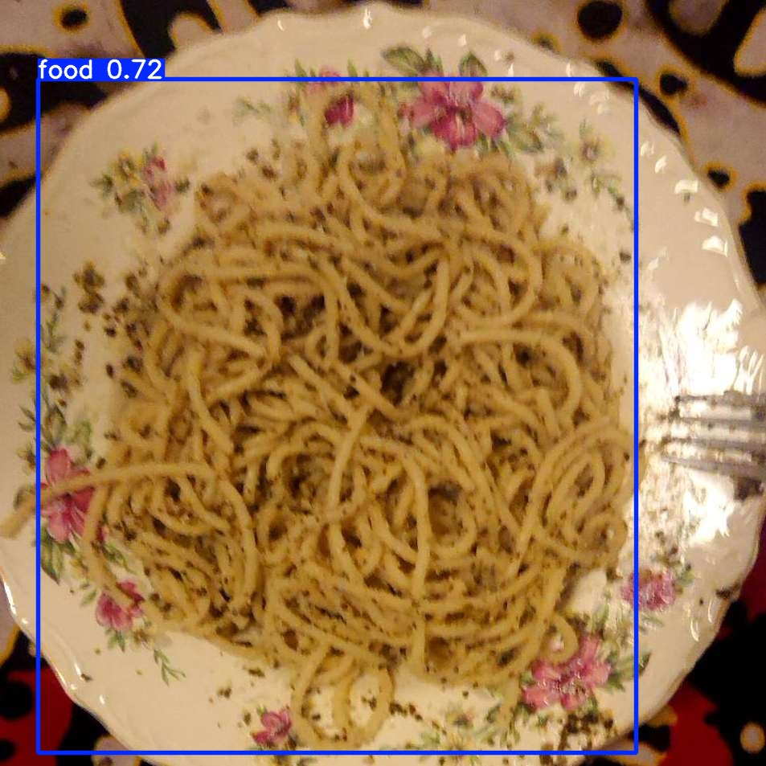

Slide 30
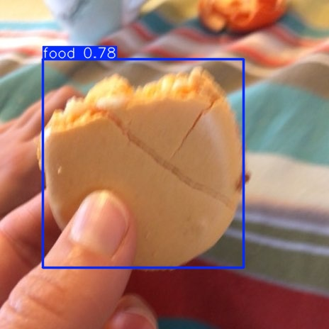

Slide 31
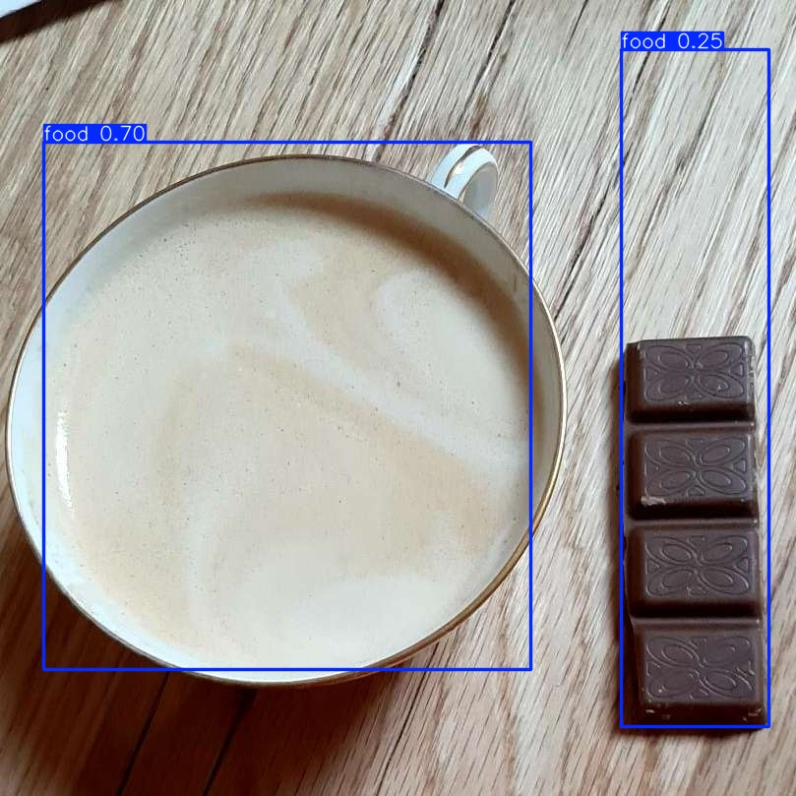

Slide 32
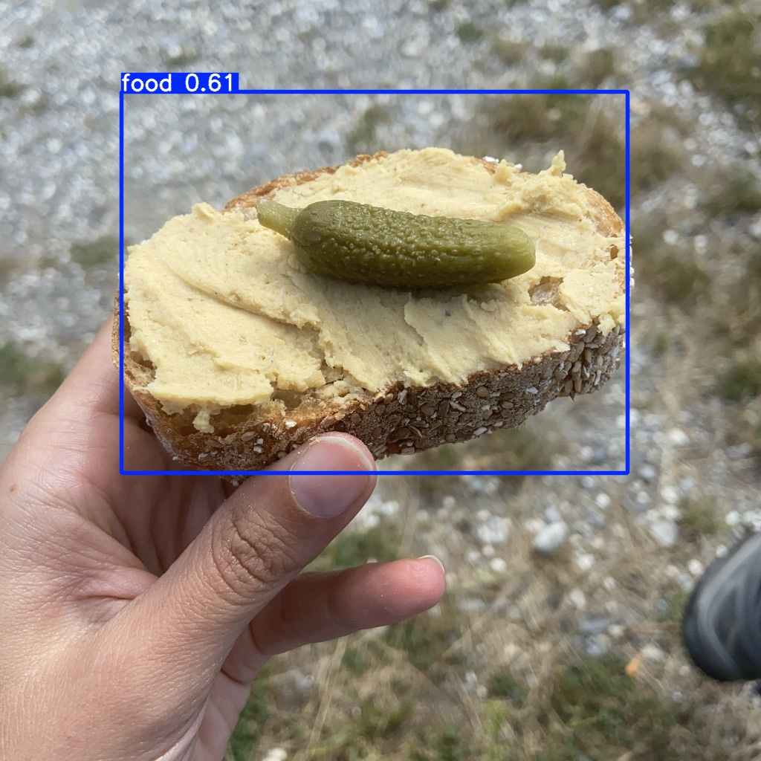

Slide 33
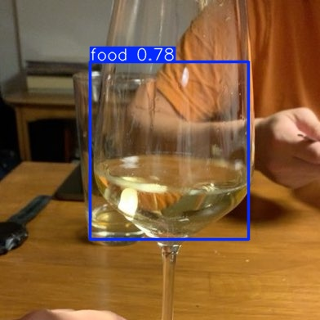

Slide 34
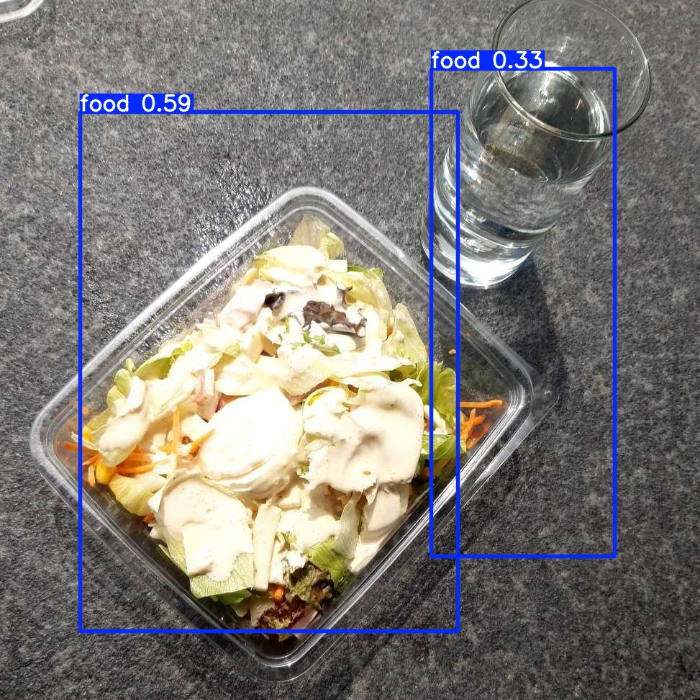

Slide 35
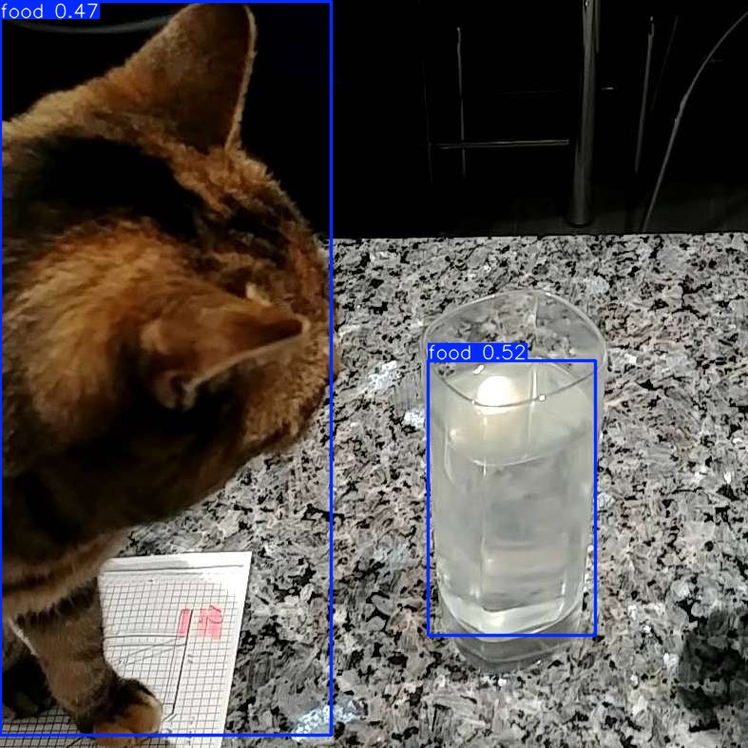

Slide 36
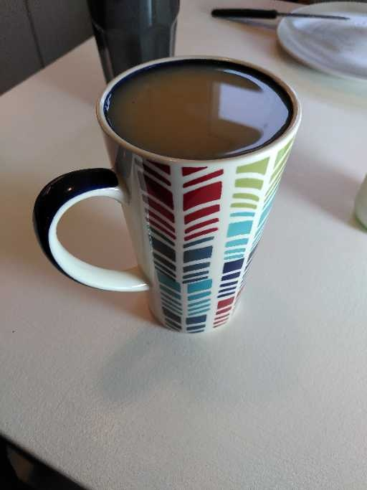

Slide 37
Yolov8n
Qualitative Evaluation – Emteq External Test Split

Slide 38
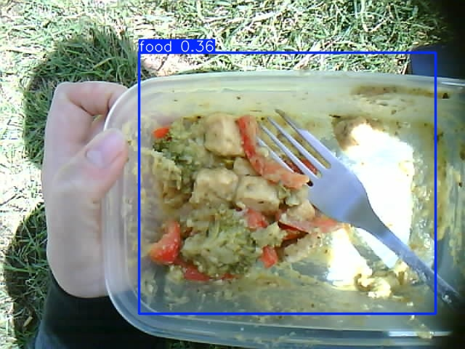

Slide 39
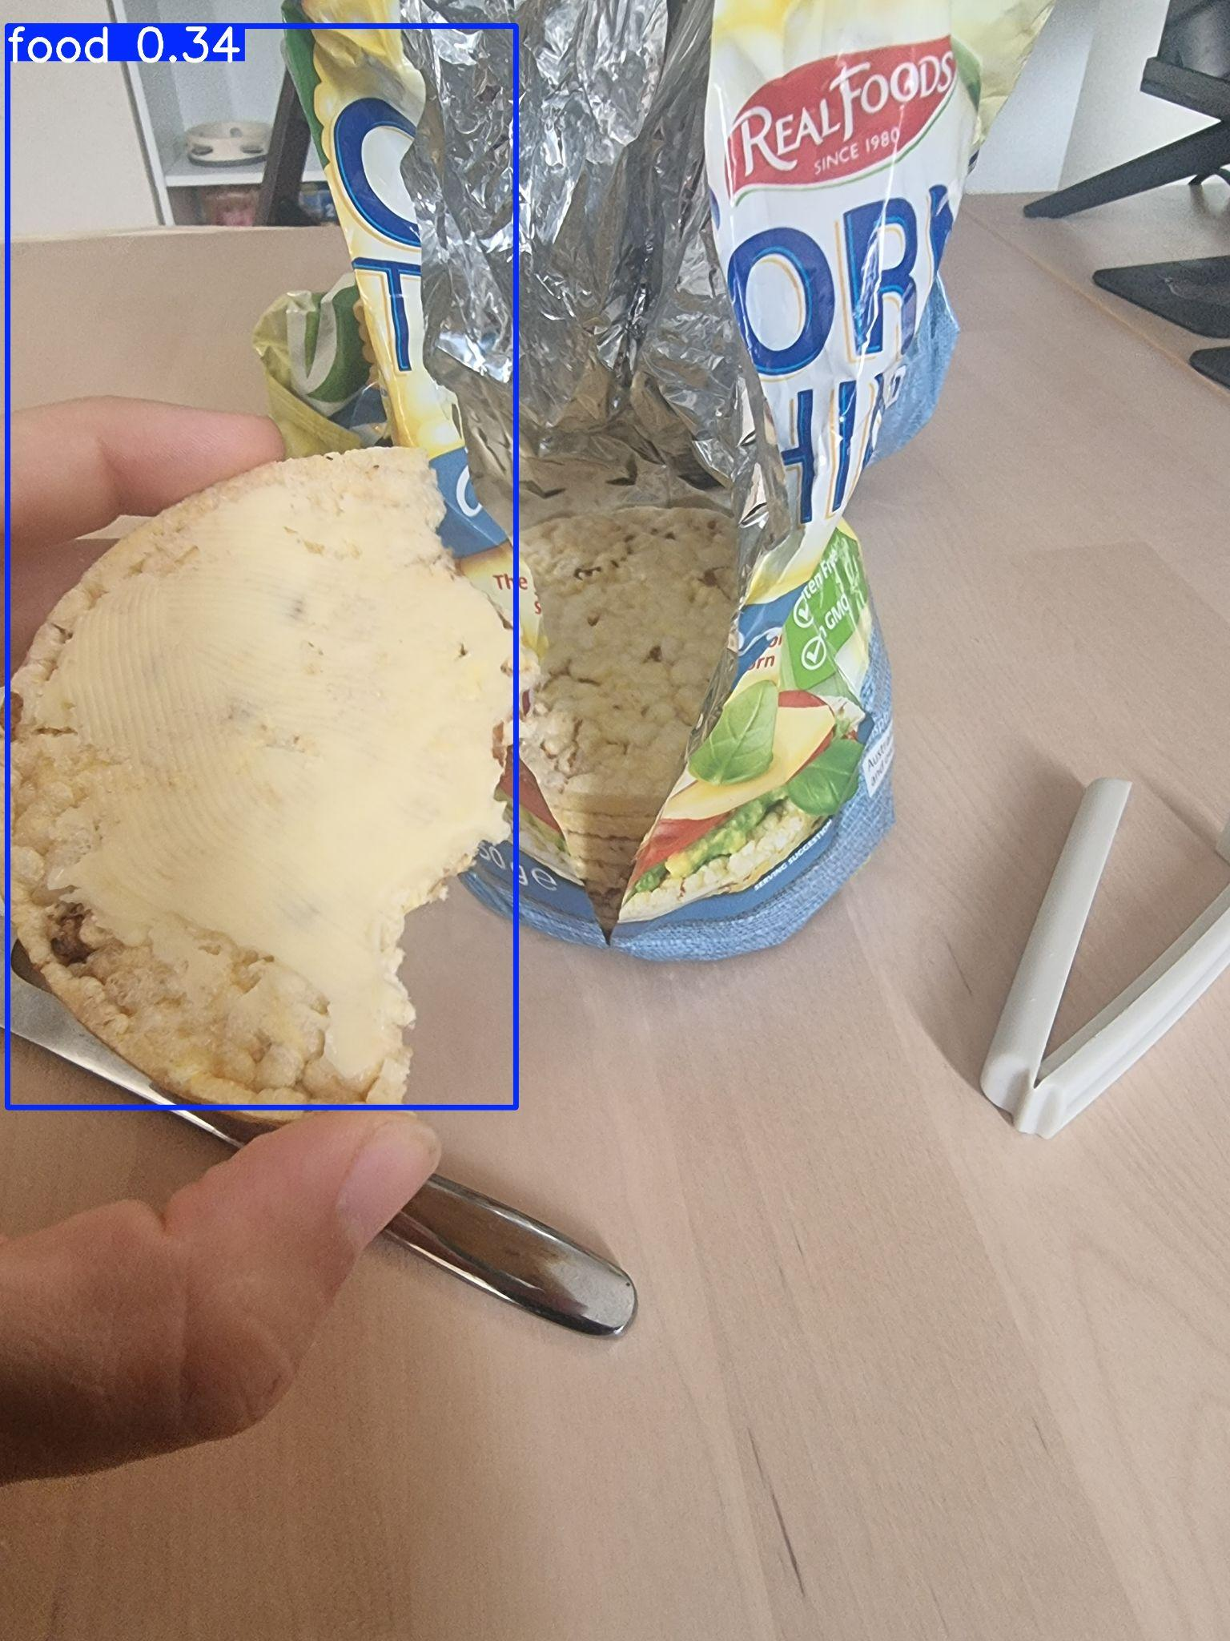

Slide 40
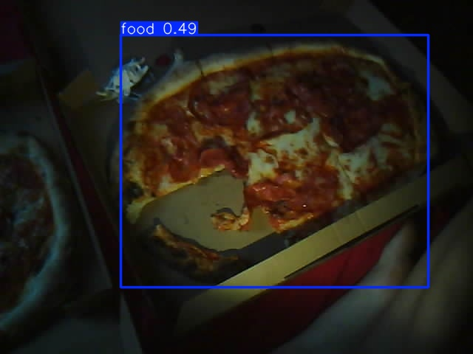

Slide 41
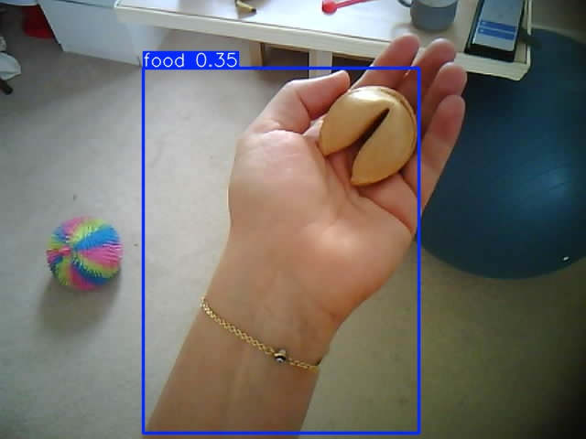

Slide 42
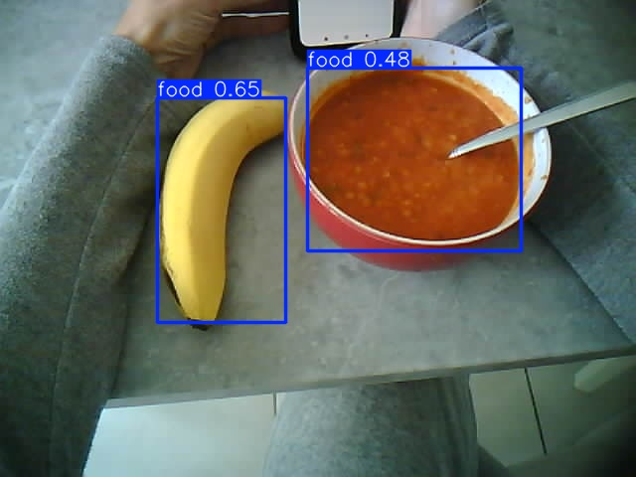

Slide 43
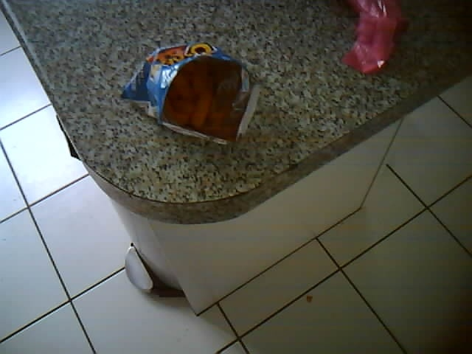

Slide 44
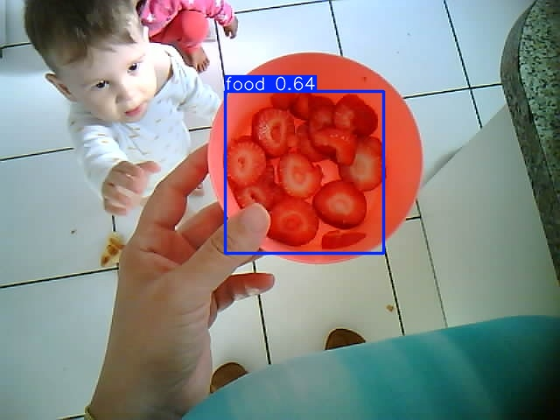

Slide 45
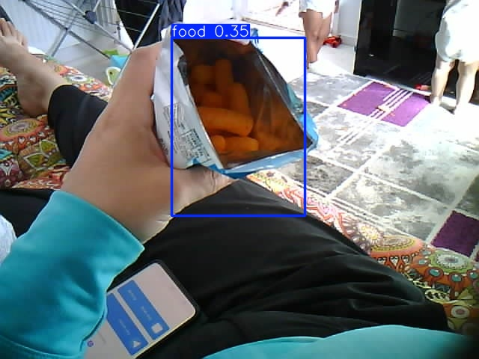

Slide 46
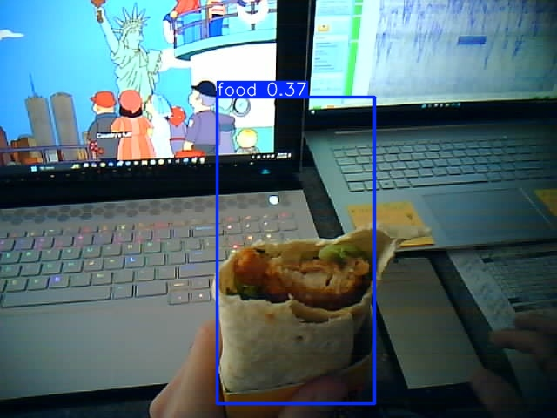

Slide 47
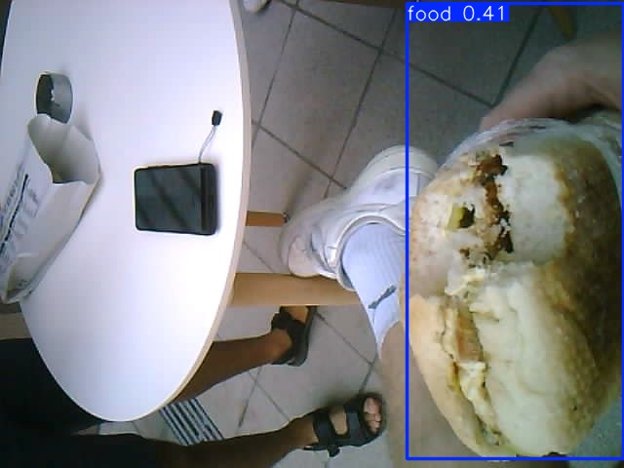

Slide 48
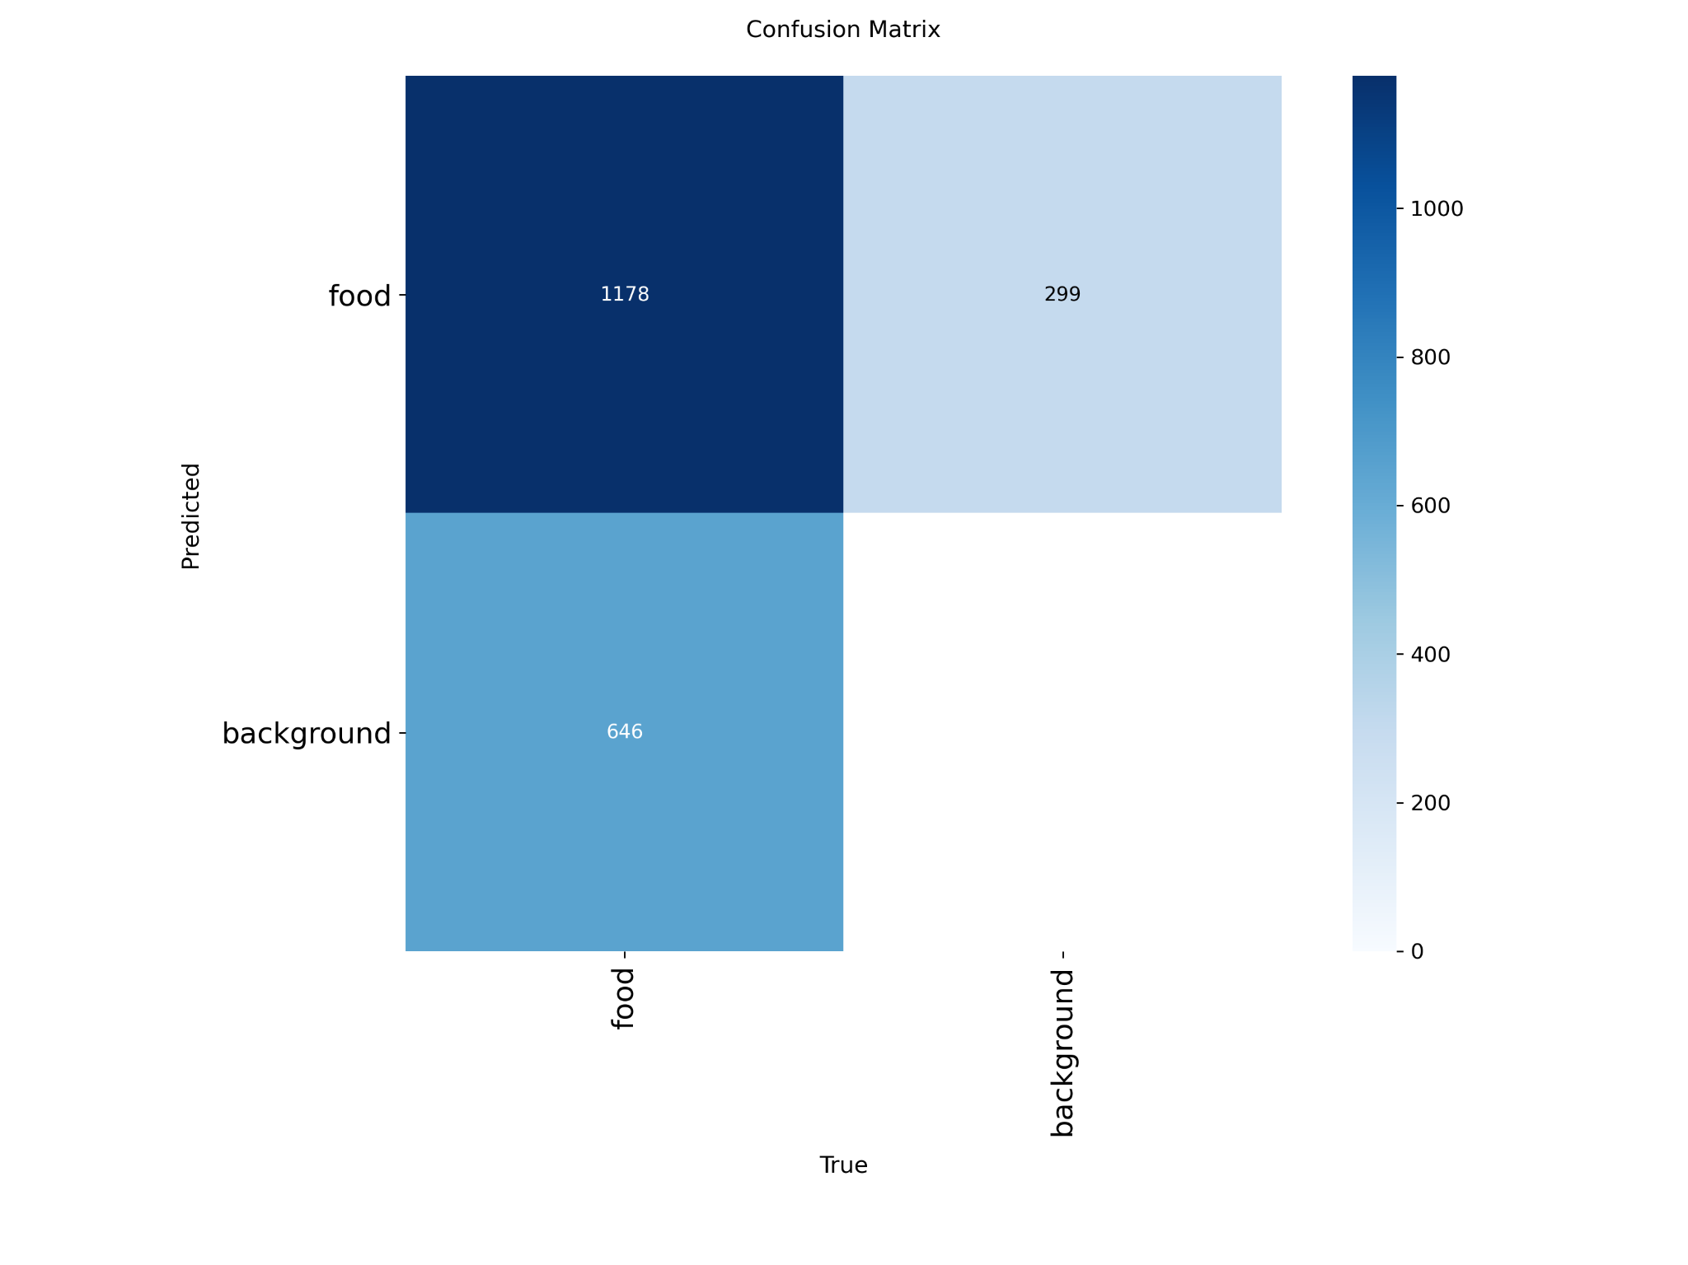

Slide 49
Yolov8s
Qualitative Evaluation – Kaggle Test Split

Slide 50
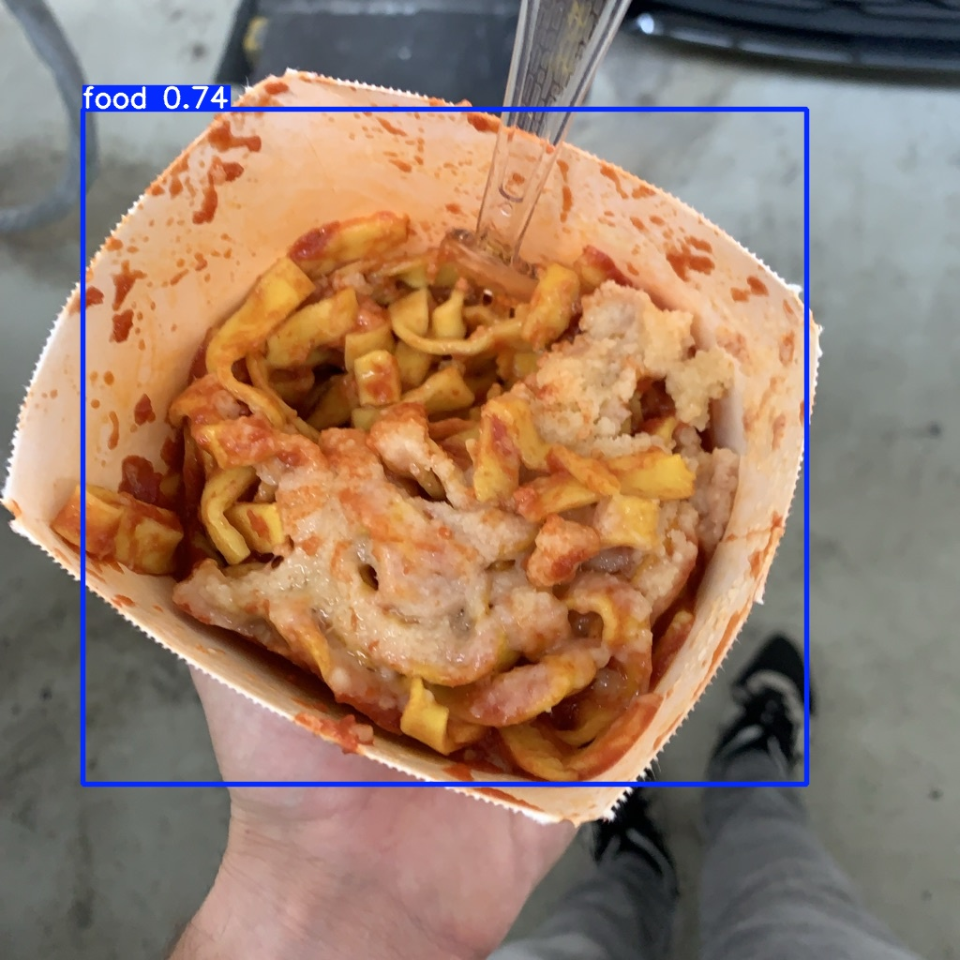

Slide 51


Slide 52


Slide 53


Slide 54


Slide 55


Slide 56


Slide 57


Slide 58


Slide 59


Slide 60


Slide 61
Yolov8s
Qualitative Evaluation – Emteq External Test Split

Slide 62


Slide 63


Slide 64


Slide 65


Slide 66


Slide 68


Slide 69


Slide 70


Slide 71


Slide 72


Slide 73
Yolov8m
Qualitative Evaluation – Kaggle Test Split

Slide 74


Slide 75


Slide 76


Slide 77


Slide 78


Slide 79


Slide 80


Slide 81


Slide 82


Slide 83


Slide 85
Yolov8m
Qualitative Evaluation – Emteq External Test Split

Slide 86


Slide 87


Slide 88


Slide 90


Slide 92


Slide 93


Slide 94


Slide 95


Slide 96


Slide 97




Slide 98
Local AI Backend Server
The backend is implemented as a FastAPI web service.
It runs on the user’s local machine.
The server receives food images from the mobile application.
It performs food classification and calorie estimation using a LLaVA vision-language model.
Communication is handled through a REST API.

Slide 99
Backend Technology Stack
FastAPI – lightweight, high-performance REST framework.
Ollama – local inference runtime for large language models.
LLaVA – multimodal vision-language model.
Python – image preprocessing and request handling.
PIL (Pillow) – image loading and resizing.

Slide 100
Image Analysis Pipeline
Mobile app uploads a food image via /analyze endpoint.
Image is loaded and converted to RGB format.
Image is resized to reduce inference time.
Image is encoded as Base64 JPEG.
Encoded image is sent to the LLaVA model via Ollama.
Model response is parsed and validated.
JSON result is returned to the mobile app.

Slide 101

Prompt Design for Food Analysis

Slide 102

Model Output Processing
LLaVA outputs text responses.
The server extracts the first valid JSON block.
Ensures robustness against extra or malformed text.
Final response contains:
label: food classification
calories: integer calorie estimate

Slide 103
Android Mobile Application Overview
Android application developed using Jetpack Compose
Performs on-device food detection using a YOLO TensorFlow Lite model
Integrates with a local LLM server for food classification and calorie estimation
Designed with a focus on privacy, offline capability, and modular AI integration

Slide 104
Image Capture and User Interaction
User captures a food image using the mobile device
Image is displayed immediately for inspection
Application provides interactive controls
Run YOLO detection
Apply privacy masking
Upload image for classification

Slide 105
On-Device Food Detection (YOLO)
Food detection is performed entirely on-device
YOLO model deployed using TensorFlow Lite
Outputs bounding boxes and confidence scores
Technical highlights (short):
Input size: 640 × 640
Confidence and IoU thresholds applied
Supports multiple bounding box formats

Slide 106
Visualization of Detection Results
Bounding boxes are rendered directly on the image
Scaling adapts to original image resolution
Visual feedback allows user verification before further processing

Slide 107




Slide 108




Slide 109
Communication with Local AI Server
Cropped food image is converted to JPEG
Sent to local server via REST API
Server performs LLaVA-based classification
JSON response returned to the app:
Food label
Calorie estimate

Slide 110
Local Data Storage
Results are stored locally using Room database
Each entry includes:
Timestamp
Food label
Estimated calories
Path to stored image

Slide 111
Daily Log and Calorie Summary
Application aggregates food entries per day
Displays:
List of meals
Total daily calorie intake

Slide 112


Slide 113
End-to-End Application Workflow
User captures food image
YOLO detects food on-device
User verifies and masks image
Cropped image sent to local LLM server
Food classification and calories returned
Results stored and displayed in daily log

Slide 114
Mobile Application Summary
Demonstrates integration of computer vision and LLMs in a real application
Combines detection, classification, and data persistence
Focuses on usability, privacy, and academic reproducibility
Serves as a foundation for future nutrition and health applications

Slide 115
04
Conclusion

Slide 116
Conclusions and Outlook
YOLOv8 models proved highly effective for food object detection when fine-tuned on a large, domain-specific dataset.
Model size matters:
YOLOv8n offers fast, lightweight inference suitable for mobile and real-time use.
YOLOv8s/m achieve better localization and higher mAP at the cost of increased computation.
Combining on-device YOLO detection with a local LLM (LLaVA) enables accurate food recognition and calorie estimation while preserving privacy and offline capability.
The proposed end-to-end system demonstrates a practical integration of computer vision and multimodal AI in a real-world mobile application.
This work provides a scalable foundation for future nutrition, health monitoring, and intelligent dietary assistance systems.

Slide 117
Thank you for your attention!
Any questions?

